Slide 1

2022年度前期 公開期末評価
Group-level Emotion Classification via Reinforced Self-training
東京都立大学 下川原研究室
Shimokawara Lab. Tokyo Metropolitan University
LIU YI
Notes:
Hello,everyone.
Im LIU YI from shimokawara Lab.
Today my presentation title is
<Group-level Emotion Classification via Reinforced Self-training>

Slide 2
Section1- Introduction
Background
Contactless Virtual Social
become popular in recent years
Smart virtual space/virtual Intelligent Agent
are expected, to help conversation on those online virtual world platforms
Terminology
Dialogue Mood
Mood is the feeling state of a person, usually includes emotions(inner) & atmosphere(outer)
Personal Emotion
Emotions are mental states caused by neurophysiological changes
Dialogue Atmosphere
Dialogue Atmosphere is a metric used to describe group-level interactions
Refers to the feeling brought about by the surrounding in a dialogue
Notes:
Firstly, I will make an briefly introduction about my study,
Background
In recent years, contactless virtual social has become more and more popular.
On those viirtual platforms, Smart virtual space/virtual interlligent Agent are expected to help better conversation on those online virtual world platforms.
For terminology, i'd like to explain what is Dialogue Mood.
Mood is the feeling state of a person usually includes emotions(inner) & atmosphere(outer).
Emotions are mental states caused by neurophysiological changes
while Dialogue Atmosphere is a metric used to describe group-level interactions
which Refers to the feeling brought about by the surrounding in a dialogue

Slide 3



Section1- Introduction
Research Objective
Chat Support Virtual Agent
In Virtual Reality
It's not easy for a player to evaluate other players' emotion and dialogue atmosphere
To help better interaction in VR
To reduce the impact of individual differences, surroundings, etc. on Dialogue Mood recognition
Improve the recognition accuracy of Dialogue Mood in VR
Support
Support
VR Interaction
Notes:
Our Research Objective wil be like this
U know, in virtual Reality, it's not easy for a player to evaluate other players' emotion and dialogue atmosphere.
So in order to help better interaction in VR,
we need to reduce the impact of individual differences, VR surroundings, etc. on Dialogue Mood recognition
to improve the recognition accuracy of Dialogue Mood in VR.

Slide 4

Section2- Related Work
Mood Enginnering[1]
→"Atmosphere"
→Proposed by the Japanese Society for Artificial Intelligence(JSAI) in 2013.
DNP(Dai Nippon Printing Co., Ltd.)——"next-generation stealth space"
Change the color of light and music in a room by using sensors to detect people’s presence &conversations and the indoor environment.
In Shohei Kato's research
They researched Dialogue Mood Estimation Focusing on Intervals of Utterance State[2]
Use Speech Sounds considering Personality Trait of Speaker for Dialogue Mood Estimation[3]
Notes:
In this section, I will introduce some related work.
Mood engineering, is a theory to study “atmosphere”and people's feelings ,was propesd by JSAI in twenty thirteen,
DNP has develeoped a “next-generation stealth space”,
which can change the the color of light and music in a room by using sensors to detect people’s presence &conversations and the indoor environment.
In Shohei Kato's research
they researched Dialogue Mood Estimation Focusing on Intervals of Utterance State
they also Use Speech Sounds considering Personality Trait of Speaker for Dialogue Mood Estimation

Slide 5
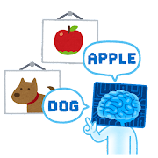
Section2- Related Work
Reinforced Self-Training[4]
Zero-shot Text Classification via Reinforced Self-training(Z Ye et al.,2020) [4]
proposed a reinforced self-training model for zero-shot learning in NLP
Reinforcement learning for relation classification from noise data(Feng et al.,2017)[5]
proposed a policy network to automatically identify wrongly-labeled instances in training set
Learning what data to learn(Fan et al.,2017) [6]
proposed an adaptive data selection strategy, enabling to dynamically choose different data at different training stages.
Notes:
Reinforced Self-Training
is a model proposed by this paper, in this study,they proposed a reinforced self-training model for zero-shot learning in NLP
There are also a lot of researches to do...for example,relation classification and data select using Reinforcement Learning trying to indentify noise data and low-quality data.

Slide 6
Section3- Proposed Model
Reinforced Self-training Model[4]
high level/quality
labeled dataset
train
Matching Model
predict
unlabeled dataset
reward
evaluation
Reinforcement Learning Policy Network
add pseudo
labeled instances
Do data selection
reward
evaluation by interaction with
VR avater and HRV changes
*This proposed Model was modified from the Reinforced Self-training model in
<Zero-shot Text Classification via Reinforced Self-training> (Z Ye et al.,2020) [4]
Avater/HRV
Notes:
This is my proposed Model,this model was modified from the the Reinforced Self-training model
in <Zero-shot Text Classification via Reinforced Self-training>
We first use high-level/haigh quality labeled dataset to train a class matching model,
then we use the matching model to predict unlabeled dataset.
On the other hand, we will train a reinforcement Learning Policy Network to do data selection based on the prediction.
and evaluate by validation dataset and get reward to update our policy network.
Based on the perfomance on the validation datasetr, we add pesudo labeled instances to our traning dataset and start next traning.
We can aslo based on the interaction with avter in VR or based on personal biological changes to return the reward to our Policy Network,but i think we need verify it.

Slide 7
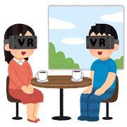

Section4- Experiment Design
Experiment Setting
APP: VRChat
Group Composition: 2 talkers a group
Participants: more than 20 different groups
Device: VIVE Pro Eye, Polar H10
Details:
(Main talker) wear sensors and VR headset
(Second talker) just login to the VR platform and talk
Each conversation lasted approximately 3 minutes
VR&Sensor
PC
communication
Main talker
Talker2
Video/PC
Evaluator
Notes:
We will conduct our Experiment in VRchat,which is a online Application that both available in VR and PC.
2 talkers in a group to talk with each other,and we planned to collect more than 20 groups' data.
We use VIVE Pro Eye and Polar H10 to collect participants's biometric infromation
Main talker will be asked to wear sensors and VR headset.
Second talker just login to the VR platform via PC and talk with Main talker.
Besides, there are serveal Evaluators to evaluate the dialogue atmosphere and Main talkers' emotion.
Main talkers and Second Talkers will also evaluate the dialogue atmosphere and Main talkers' emotion after the experiment.

Slide 8
Section4- Experiment Design
Raw Data
ECG
Audio
Head traking
feature extraction
select data
Samples
Train class
Matching Model
Eye tracking
Lip tracking
Experiment schedule
Arousal
1st experiment (positive group)
in a Relax VR environment
Stay and Relax
Conversation on a particular topic
in a Joy VR environment
Stay and Arouse Joyness
Conversation on a particular topic
2nd experiment (negative group)
in a Sad VR environment
Stay and recall Sadness
Conversation on a particular topic
in a Fear/Disgust VR environment
Play and Experience
Conversation on a particular topic
Fear/
Disgust
Joy
Valence
Sad
Relax
Notes:
We will collect ECG,Audio, Head/Eye/Lip Tracking as Raw Data, and do proper feature extraction to make dataset
We will first manually select data samples to train class Matching Model, and then train reinforcement Learning Model to select data automatically.
Our Experiment schedule will be like this.
We will firstly do positive group experiment in Relax/Joy VR World.
and second sxperiment wiil be nagative group in Sad, Fear or Disgust VR world
The four wolrds is correspond to the Arousal-Valnece Coordinate

Slide 9
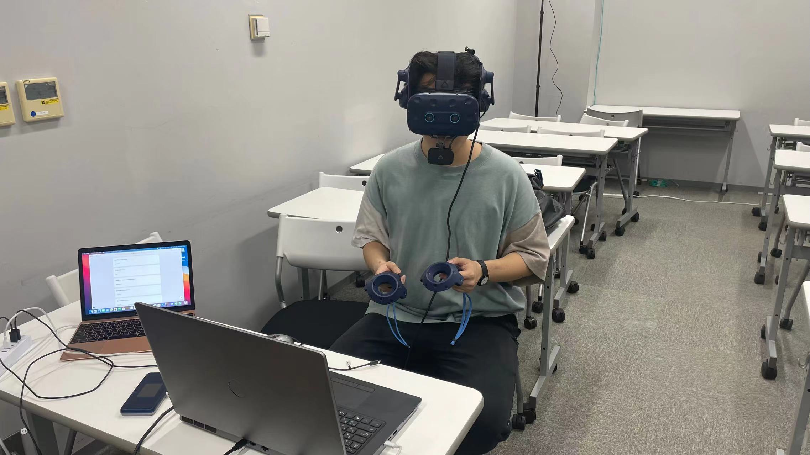
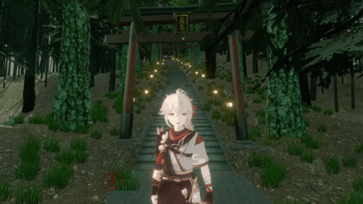
Section4- Experiment Design
Experiment Images
Enjoy Endless Experience in Virtual Reality!
Play & Talk in VRChat!
Notes:
This is our Experiment Images
Participants will be asked to wear VR headset , then play& talk in VRchat
Just like this.
Meanwhile, sensors will record biometric data into csv.
I had collected Six groups' data.

Slide 10
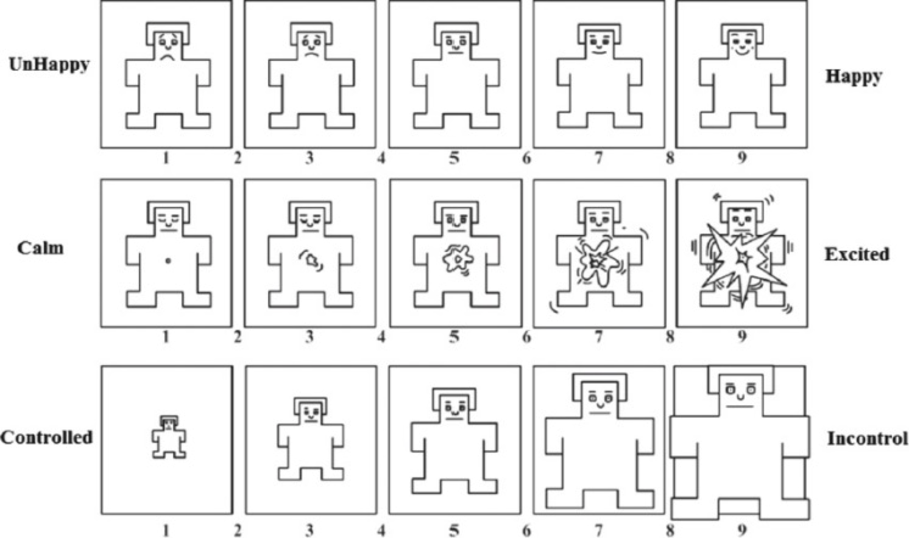
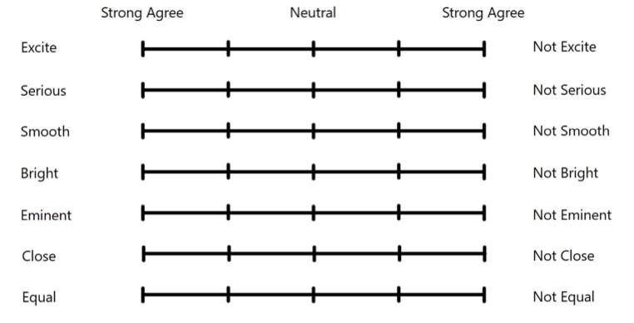
Section4- Experiment Design
Questionnaire
they will be asked to answer Multidimensional Assessment of Interoceptive Awareness(MAIA) questionnaire to measure multiple dimensions of interoception
Before the Experiment
After the Dialogue
Participants will evaluate the
Dialogue Atmosphere
Evaluate main talkers' emotions by
SAM questionnaire
Notes:
Before the experiment, Participants will be asked to answer Multidimensional Assessment of Interoceptive Awareness(MAIA) questionnaire to measure multiple dimensions of interoception
After the Dialogue,participants will be asked to evalute main talker's emotions by SAM questionnaire.
They also need to evalute the whole dialogue atmopshere

Slide 11
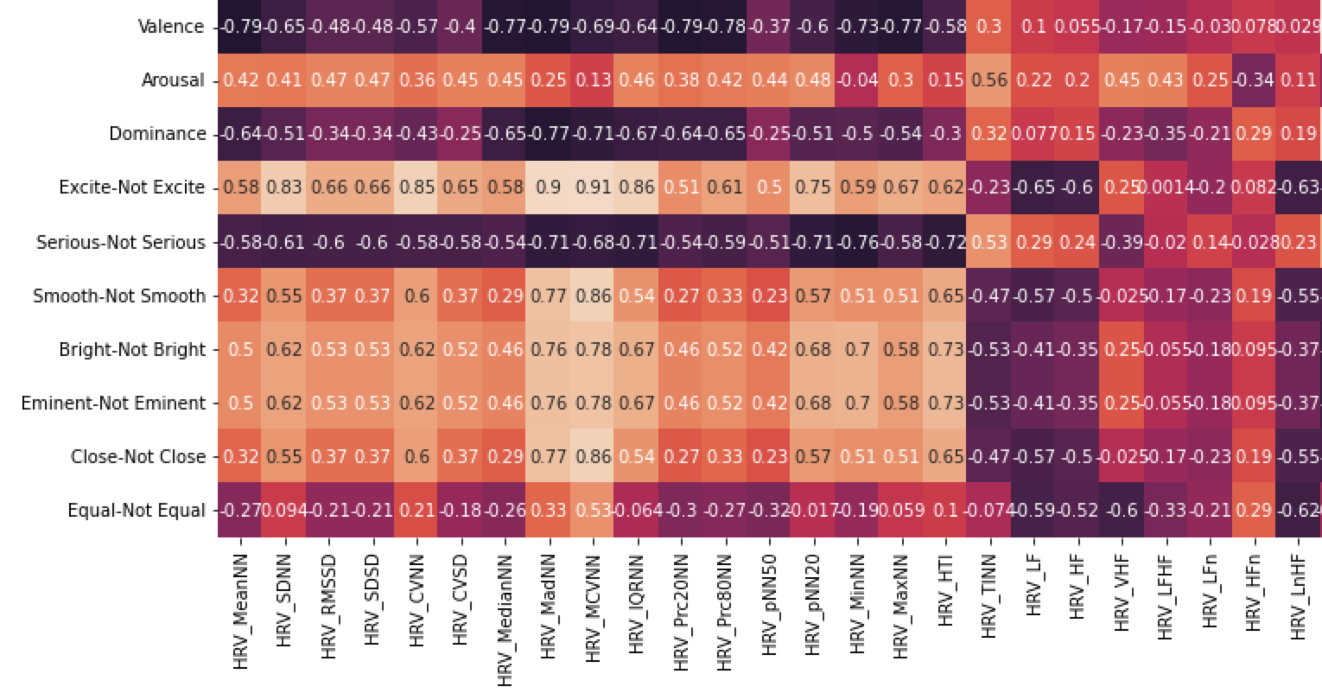
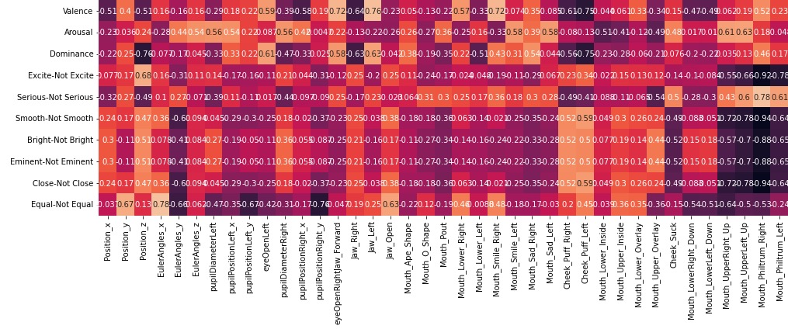
Section5- Data Analysis
Correlation Analysis
Correlation analysis of HRV
and Emotion&Atmosphere
Correlation analysis of Gaze/Head/Mouth Movement and Emotion&Atmosphere
Individual differences
EX.Some Participants’ Mouth Movement has a greater correlation with Dialogue Mood, but some Participants are not
Notes:
We make a correlation Analysis between HRV/Gaze/Head/Mouth/Lip Movement and Emotion&Atmosphere for each participants
We can find individual differences exists in our data.
For example, Some Participants’ Mouth Movement has a greater correlation with Dialogue Mood,
but some Participants are not

Slide 12
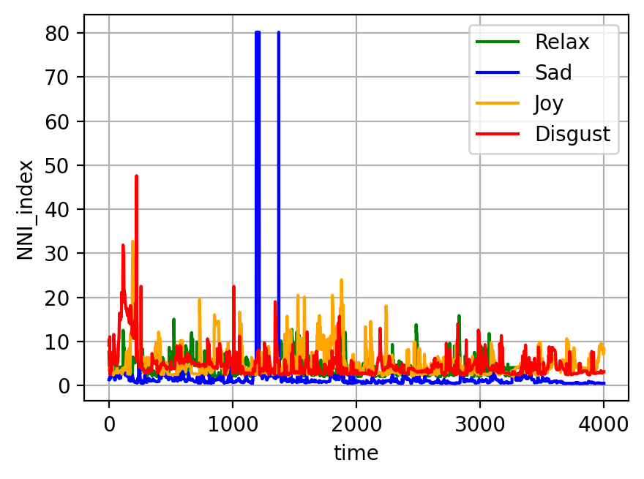
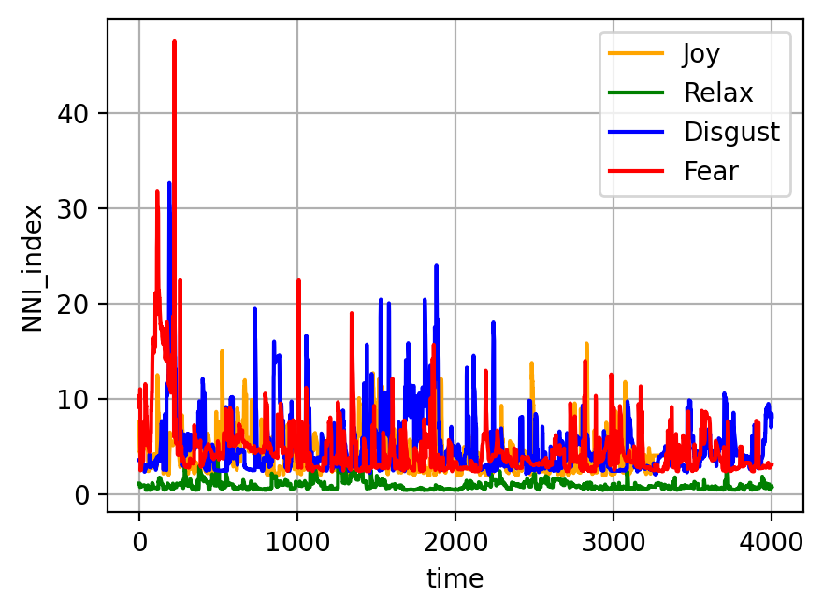
Section5- Data Analysis
NNI Visualization
Nearest-Neighbor Index (NNI)
of left eye in non-dialogue
Nearest-Neighbor Index (NNI)
of left eye in dialogue
Notes:
For Eye Tracking, i also used NNI to extract features of eye movement in both non-dialogue settings and dailogue settings.
We can figure out that in non-dialogue conditions, Sad and Relax and a relatively low NNI, but DIsgust has a haigher NNI.
For Dialogue settings, Fear&Disgust has a fluctuated NNI, but Relax have a relatively stable NNI.

Slide 13
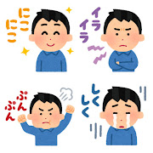
Section6- Reinforcement Learning Network
Reinforcement Learning Network
(1)State:
preprocessed biometric data and confidence point
(2)Action:
Two class, whether choose this sample or not
(3)Reward:
Based on the model’s performance on validation set
(4)Policy Network:
multi-layer perception(MLP)
Input is State
Output is Action’s probability distribution
Notes:
In this section,
I will introduce my Reinforcement Learning Network
State will be preprocessed biometric data and confidence point
Action has two class, namely whether choose this sample or not
Reward will base on the model's performance on validation set
And for Policy Network
We consider to use multi-layer perception
The input is State, and the output is Action's probability distribution

Slide 14
Section7- Future Plan
Research Plan
Do Data Visualization&Clustering..etc to Select Samples
Analyze Self-report&MAIA&Data Distribution
Train Machine Learning Model, investigate whether the model is able to draw out individual differences to get a higher score
 |  | SVM | SVM+RL | LSTM | LSTM+RL | Transformer | Transformer+RL
Emotion | Valence
 | Arousal
 | Dominace
Atmosphere | Excite
 | Serious
 | Smooth
 | Bright
 | Eminent
 | Close
 | Equal
Notes:
Do Data Visualization&Clustering to select high-confidence samples
And Analyze the relation between Self-report&MAIA&Data Distribution
Then we will train Machine Learning Model, to invertigate whether the model is able to draw out individual differences to get a higher score for individuals.

Slide 15
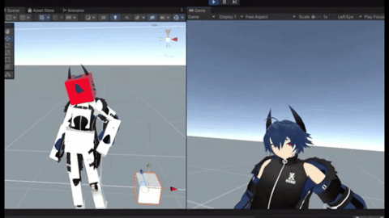
Section8- Conclusion&Discussion
Conclusion
A Reinforced Self-training model will be applied to dialogue mood recognition
We alter the VR environment to explore the effect of ambience on dialogue mood,
as well as the effect on collaborators' assessment.
Our study aims to solve Self-reporting unaccurate, Individual differences, Small sample size problem
Our study expect to verify that data collected from daily conversations could be applied to Reinforced Self-Training
Discussion
Use Eye Tracking to connect Users and other Objects(Avaters/Players)
to provide a more interesting interaction in VR
Notes:
A Reinforced Self-training model will be applied to dialogue mood recognition under conversation conditions，
We alter the VR environment to explore the effect of ambience on dialogue mood, as well as the effect on collaborators' assessment.
Our study aims to solve Self-reporting unaccurate, Individual differences, Small sample size problem
Our study expect to verify that data collected from daily conversations could be applied to Reinforced Self-Training
Discussion
We can Combine Li'kun's research, to connect Users and other Objects(Avaters/Players) in VR world,
to get a more accurate estimation in Dialogue Mood.

Slide 16
References
References
[1] Daisuke Katagami. Could we artificially create atmo_x0002_sphere? In The 27th Annual Conference of the Japanese Society for Artificial Intelligence(2013), page 2 pages.The Japanese Society for Artificial Intelligence, 2013.
[2] Kaoru Toyoda, Yoshihiro Miyakoshi, Ryosuke Yaman_x0002_ishi, and Shohei Kato. Dialogue mood estimation focus_x0002_ing on intervals of utterance state. Transactions of the Japanese Society for Artificial Intelligence, 27(2), 2012.
[3] Tatsuya Hasegawa and Shohei Kato. Dialogue mood estimation from speech sounds clusterized with speak_x0002_ers’ personality traits. In 2019 IEEE 8th Global Confer_x0002_ence on Consumer Electronics (GCCE), pages 399–401. IEEE, 2019.
[4] Zhiquan Ye, Yuxia Geng, Jiaoyan Chen, Jingmin Chen, Xiaoxiao Xu, SuHang Zheng, Feng Wang, Jun Zhang, and Huajun Chen. 2020. Zero-shot Text Classification via Reinforced Self-training. In Proceedings of the 58th Annual Meeting of the Association for Computational Linguistics, pages 3014–3024, Online. Association for Computational Linguistics.
[5] Feng, J., Huang, M., Zhao, L., Yang, Y., & Zhu, X. (2018). Reinforcement Learning for Relation Classification From Noisy Data. Proceedings of the AAAI Conference on Artificial Intelligence, 32(1). https://doi.org/10.1609/aaai.v32i1.12063
[6] Fan Yang, Tian Fei, Tao Qin, Jiang Bian, and Tie-Yan Liu. Learning what data to learn, arXiv preprint arXiv:1702.08635, 2017.
Notes:
This is my References

Slide 17
ご清聴・ご清視ありがとうございました
Thank you for your kind attention.
Notes:
Thank you for your kind attention

Slide 18
Section0- Research Route
Master1
<Sensor Fusion-based Emotion Classification In Virtual Reality Using Machine Learning>
2021.8
midterm presentation
2022.3
NCSP22 oral presentation
2021.9-11
experimen&ML
Master2
<Sensor Fusion-based Group-level
Emotion Classification In Virtual Reality>
2022.8
midterm presentation
2023.3
Graduation Thesis
2022.9-11
experiment&ML
<Group-level Emotion Classification via Reinforced Self-training>

Slide 19
Section4- Experiment Design
Experiment Objective
Find
Gaze/Mouth movement/Heart rate
connection?
Dialogue Mood
How
different VR settings(VR world)
effect
Dialogue Mood?
Self-reporting not accurate
Individual differences
Small sample size
problem
Solve
data collected from daily conversations
Reinforced Self-Training?
Can
be applied to

Slide 20
Section4- Experiment Design
Communication setting
VR world setting
evaluate the
dialogue atmosphere
and self-report own emotions
evaluate the
dialogue atmosphere
and player1's emotions
Arousal
VR&Sensor
PC
Fear/Disgust
Joy
communication
Player1
Player2
Valence
Sad
Relax
Video/PC
evaluate the
dialogue atmosphere
and player1's emotions
*4 kinds of world that
match up to 4 quadrants
Player3

Slide 21
Section5- Data Processing
Data Flow
ECG
R-R Interval
Heart Rate Variability(HRV)
Audio(wav)
Time-domain Audio Features
Manually select samples
Eye tracking Data
Pupil Diameter&EyeOpen
Train class
Matching Model
Pupil Position
Nearest Neighbor Index
of pupil position
Head position&rotation

